Slide 1

Story of Citi Bikes
New York
Presented by: Nazima Khan

Slide 2

Goal for today
Some background on Citi Bikes
Exploratory analysis
Make predictions and turn data into a user-friendly app
Tools used
Further analysis
How can you contribute?

Slide 3

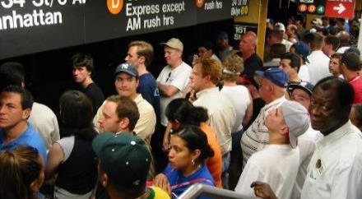

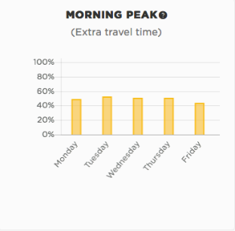
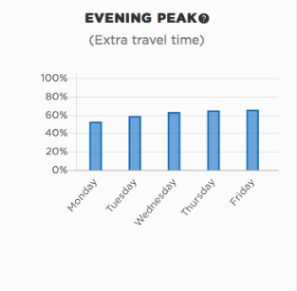
Citi Bikes

Slide 4

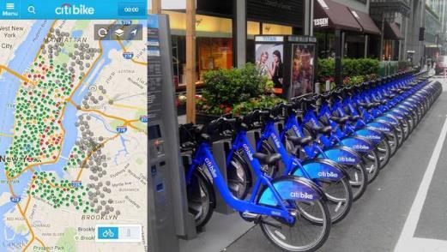
Citi Bikes facts
According to NYCDOT statistics, 56% of all automobile trips within the city are under 3 miles
Opened in May 2013 with 332 stations and 6,000 bikes
Expanded to 603 stations, 55 neighborhoods, and 10,000 bikes
Largest bike sharing program in the United States.

Slide 5

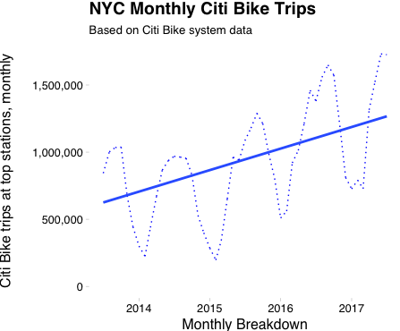
Growth
Ridership doubled in 3 years
Heavy usage in summer time
1M+ rides per month

Slide 6


Data
Source
Used the Citi Bike data for the month of July 2017 (approximately 1.5 million observations).
https://www.citibikenyc.com/system-datamillion
Variables
User Types = Customers/Subscribers
Trip duration (in seconds).
Timestamps for when the trip started and ended.
Station locations for where the trip started and ended (both the names and coordinates).
Rider’s gender and birth year - this is the only demographic data we have.

Slide 7


Organizing Data
Read, Read, Read!
Studied variables and their types
Searched for missing values (i.e. Birth Year had the most missing values)
Stripped Date and Time
Applied Feature Engineering
Added variables such as: Hour, Days, Weekdays, Age Group, etc.
Formed a clean data frame

Slide 8

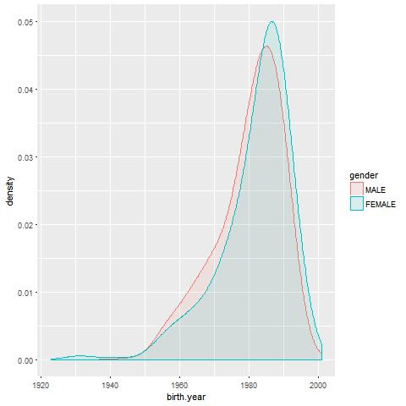
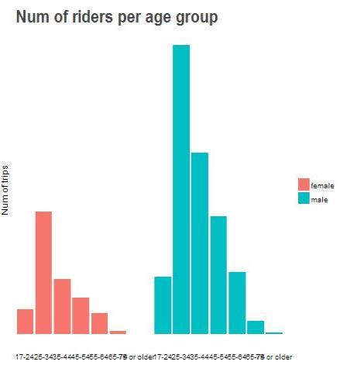
Visualize Data
Male and Female- both biker’s in Age group 25-35yrs are the highest riders.
Note : Older women bike less

Slide 9
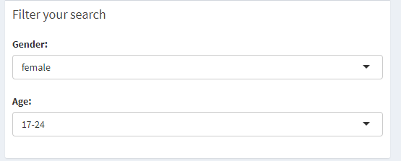
Designed a User-Friendly App using only Analysis
Step 1: Filter Your Search by gender and age and find people you want to be with

Slide 10
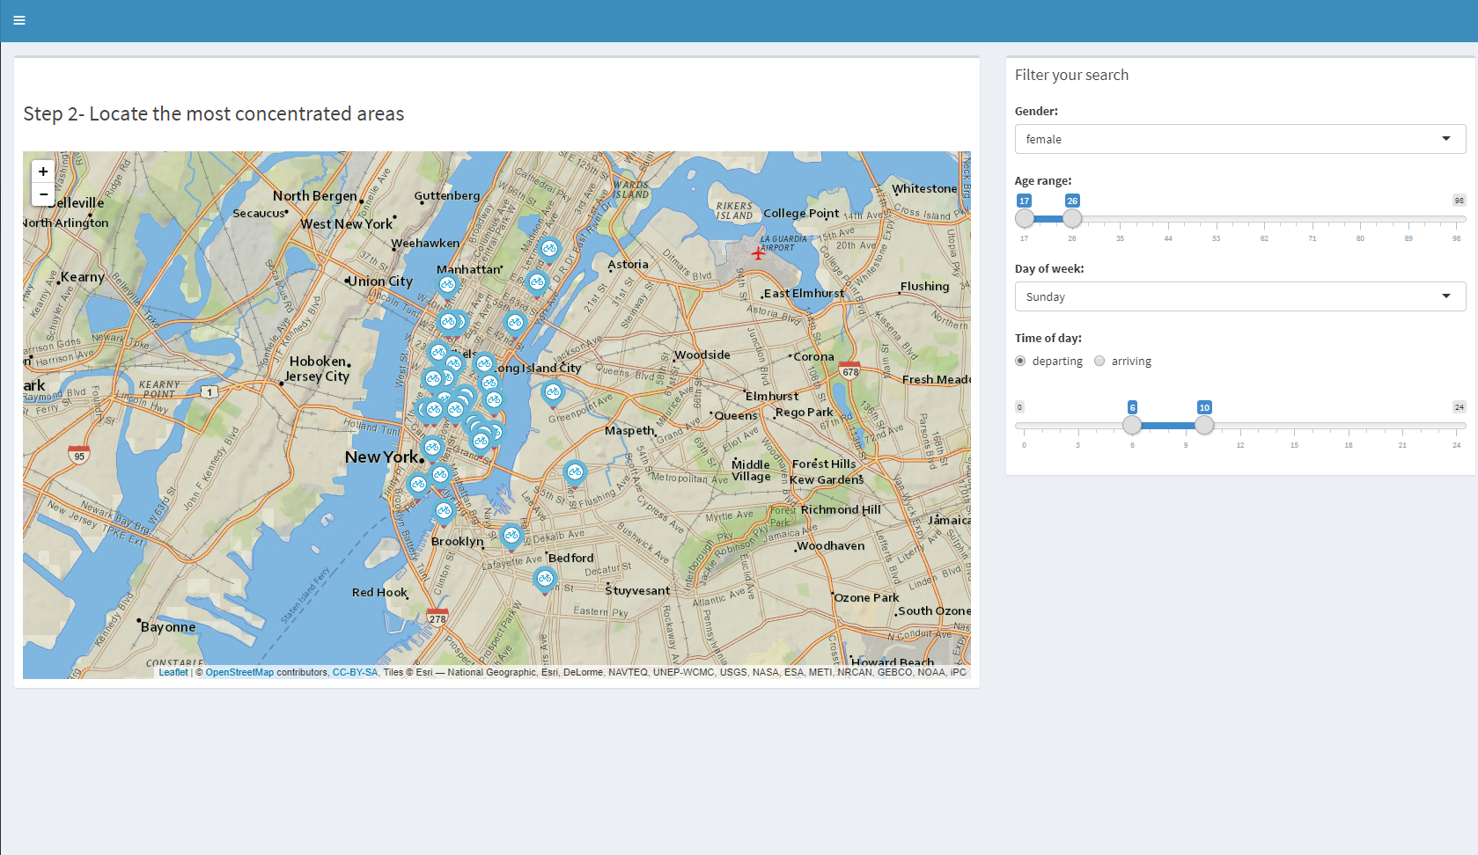
Designed a User-Friendly App using only Analysis
Filter search by gender, age range, day of week, and time of day

Slide 11

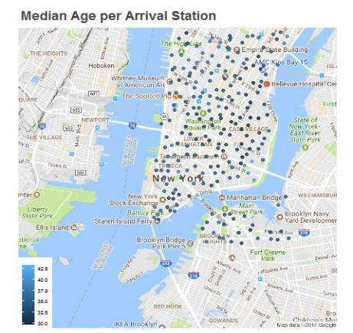
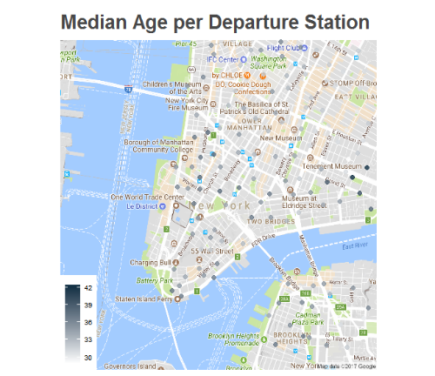
Who is riding where?
With map plotting we can spot the location of the bikers as per their ages.

Slide 12
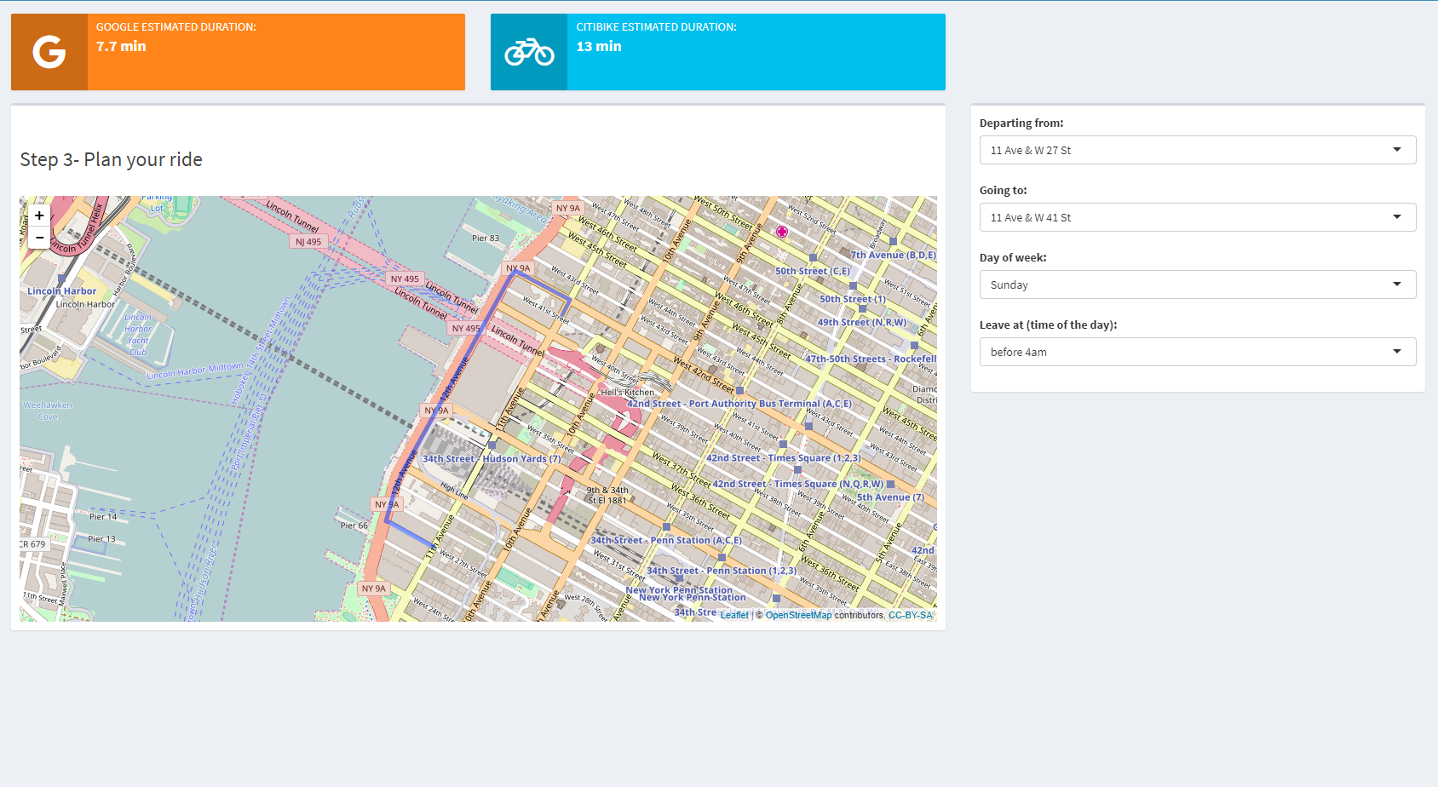
Google Views package helps you find directions

Slide 13

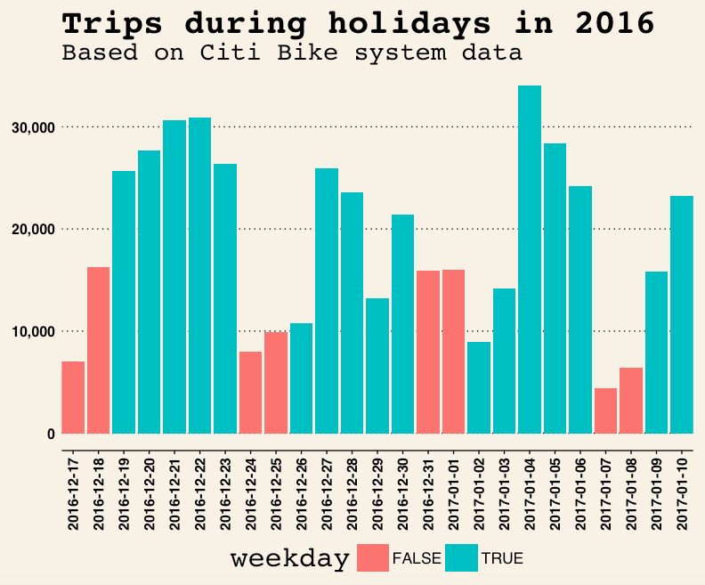
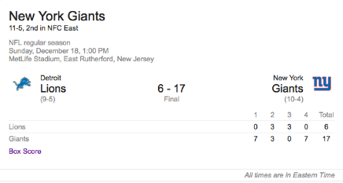
Holidays
More useful during holidays
Heavily used during public events
Giants game on Dec. 18, 2016

Slide 14
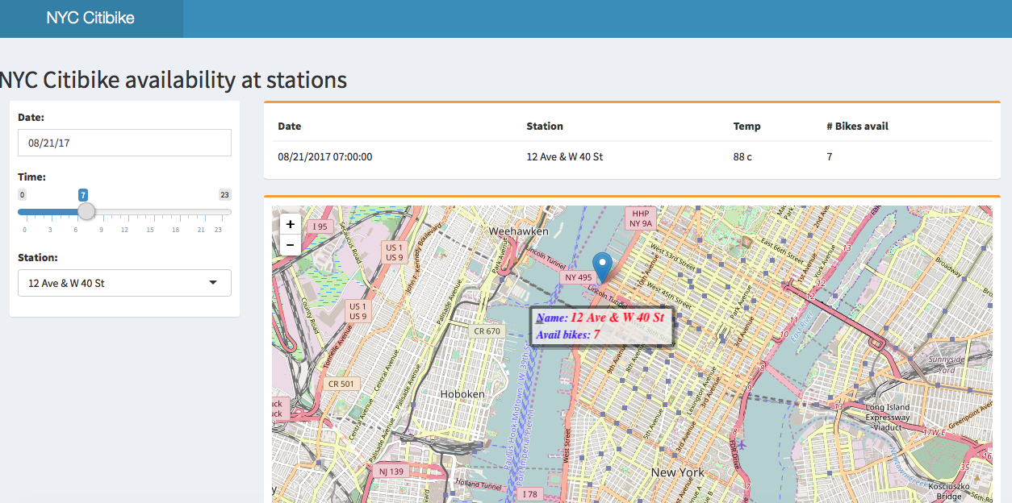
What can we predict?
Can we predict number of bikes at a station for next 7 days?
What happens at each station?
What do we need to predict?
Response variables
Bikes_arrived
Bikes_departed
Bikes_removed
Bikes_added

Slide 15

Tools
Analysis done in R
PostgreSQL backend
H2o deep learning package
Train/Test split
2015-2016 full year data/2017 until July
Packages
ggplot2
Lubridate
Dplyr
ggmap
Google Views (Map key provided by Google)

Slide 16
Further Analysis
First ideas for expanding the bicycle network based on actual usage data
Possibility of forecasting user behaviors for specific bike stations
Predict user numbers for specific stations to plan marketing measures
Predict the demand for bikes at specific stations
Identify areas with a lack of rental stations
Examine how the proximity of bike stations to subway stations affects the user numbers

Slide 17

How can you contribute
Code available on github
https://github.com/Nazima54/citibike-analysis
https://github.com/mkorrapati/citibike.git
App is available at
https://citibike-mkorrapati.shinyapps.io/citi_bike_analysis/
https://citibike-Nazima_kh.shinyapps.io/citi_bike_analysis_user/

Slide 18
Q&A
Thank You!
Nazima Khan
Murali Korrapati
Vivek Pruthi

